Slide 1
Review of Arm-IMU forecasting summer work
Valerio Gomez-Frittelli

Slide 2
Initial forecasting approach
Forecast daily average of activity count, for periods of one week, and evaluate as that week of data comes in.
Use daily average with one-week horizon in the hope of more useful forecasts
Began experimenting with restricting training data by phase of recovery, found that including only recent phases (Optimization, Implant+Rehab, etc.) helps with performance.

Slide 3
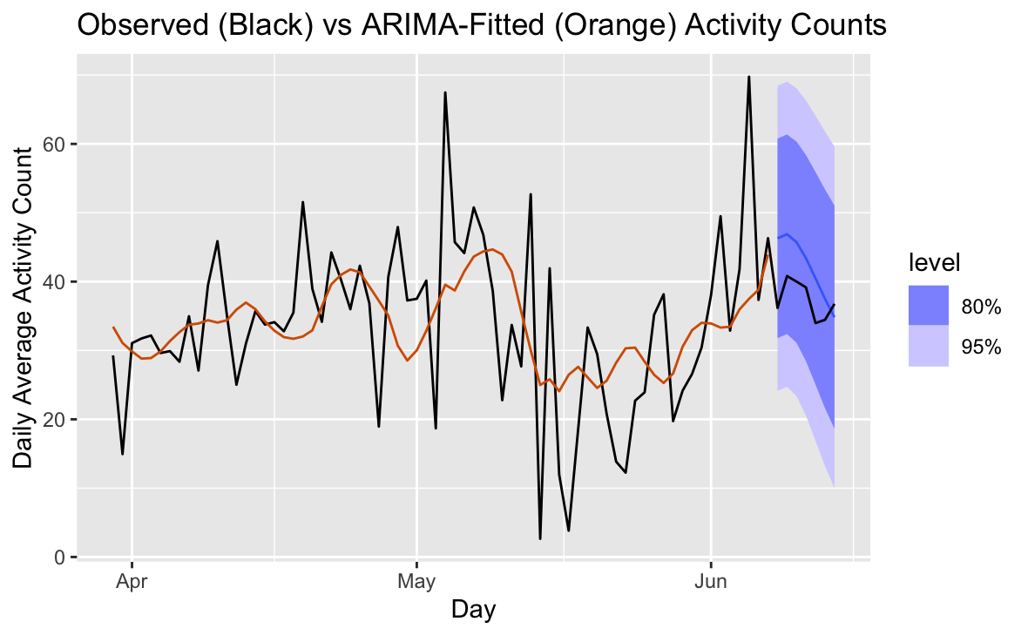
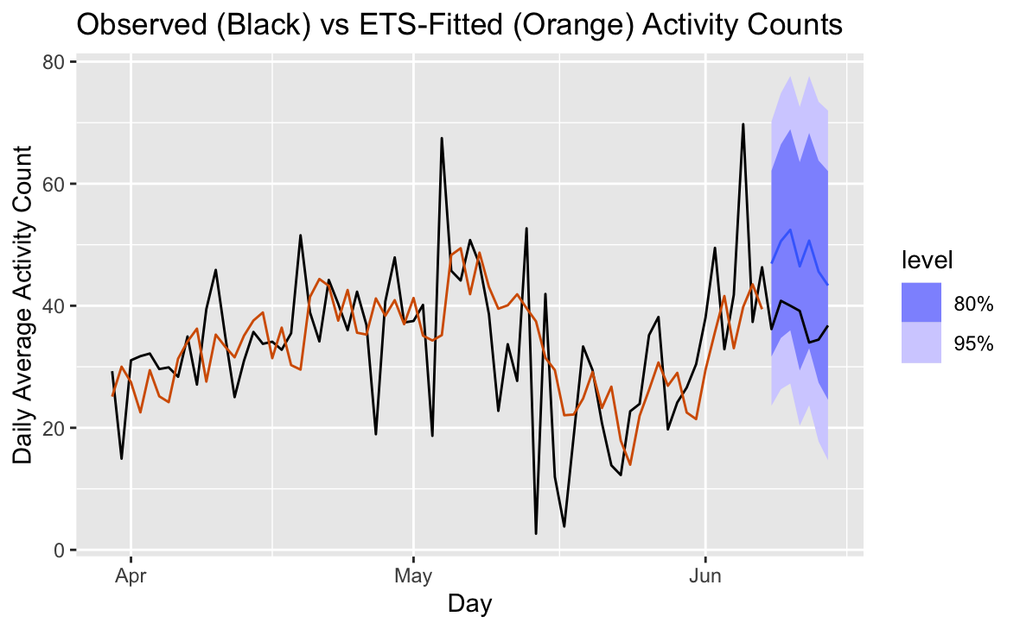
Original ETS/ARIMA forecasting
SPT04, (Opt, Imp + Rehab)
SPT04, (Opt, Imp + Rehab)

Slide 4
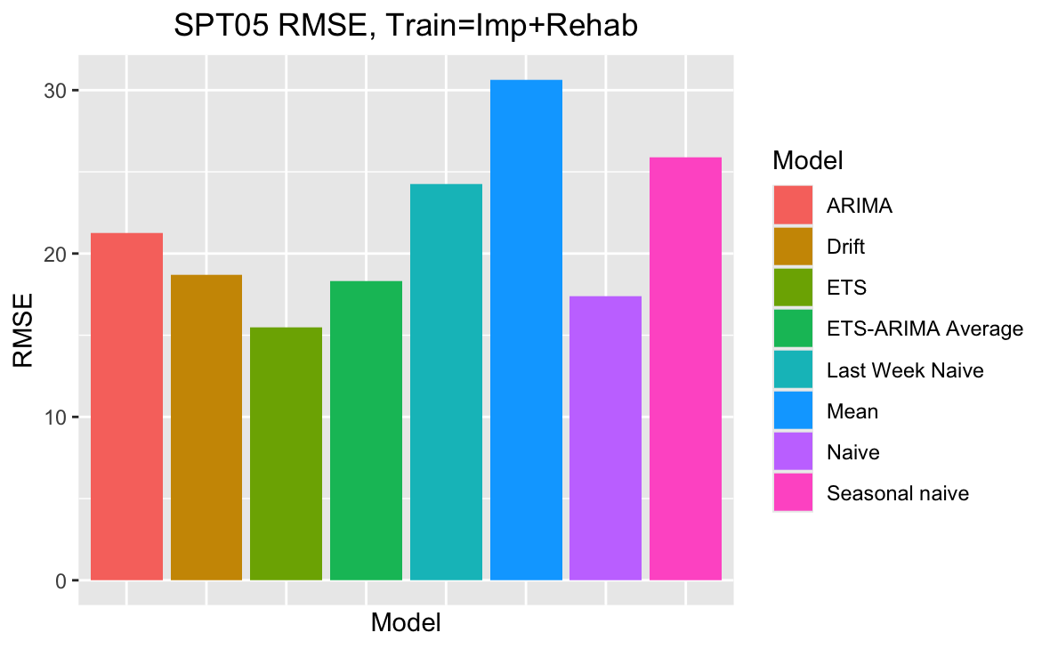
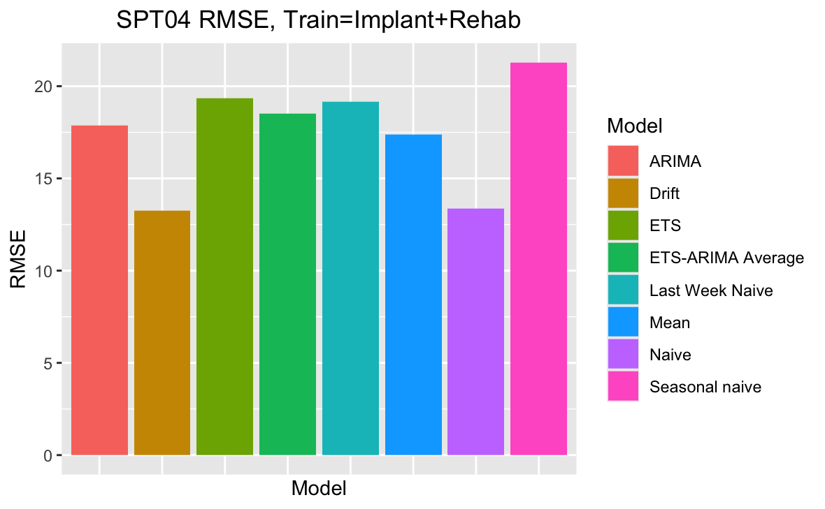
Initial evaluations of ETS/ARIMA
Models were initially evaluated too simply, using the most recent available week of data to compare models by RMSE.
Outlook was mixed, often with model performance varying greatly by week.
The idea of backtesting models to make evaluations robust came later.

Slide 5
Training Neural Network Architectures
Can we train a neural network that achieves better prediction than ETS/ARIMA (or just baselines)?
Models used: MLP, RNN, GRU, LSTM
Loss plot, final train set predictions, and test set predictions shown
Final models were chosen using early stopping; loss plots show more (unused) epochs to demonstrate that overfitting occurs past the point of the final model and that training is complete

Slide 6
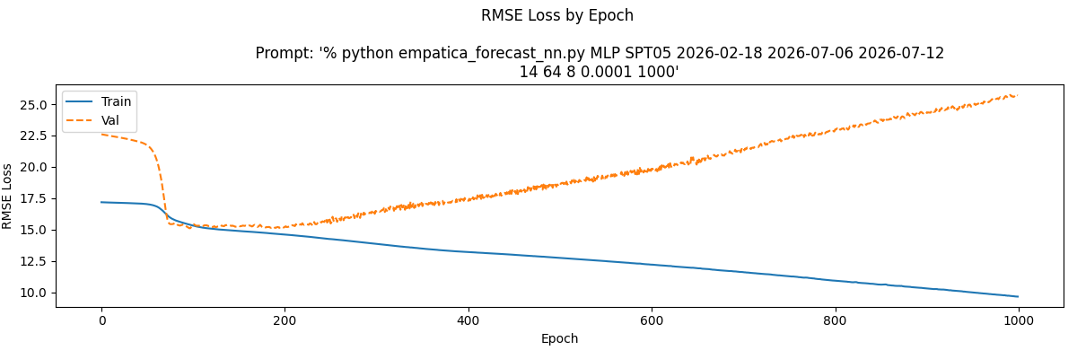
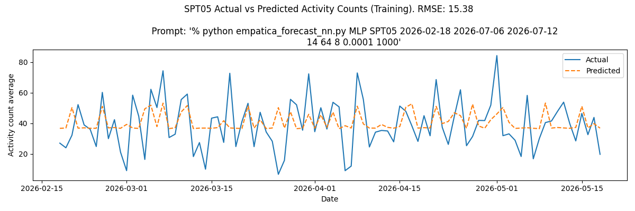
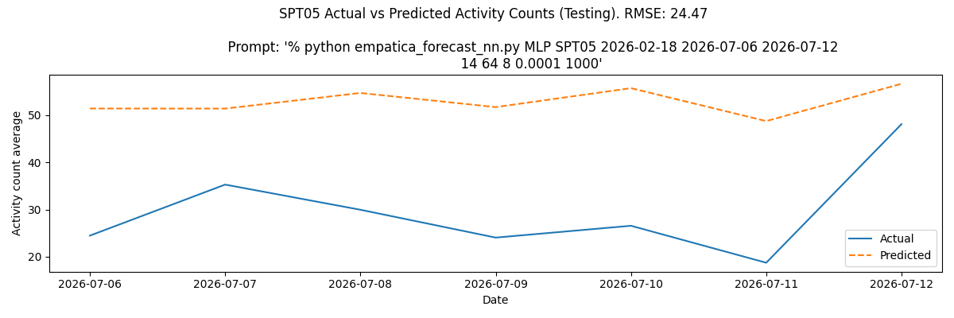
MLP

Slide 7
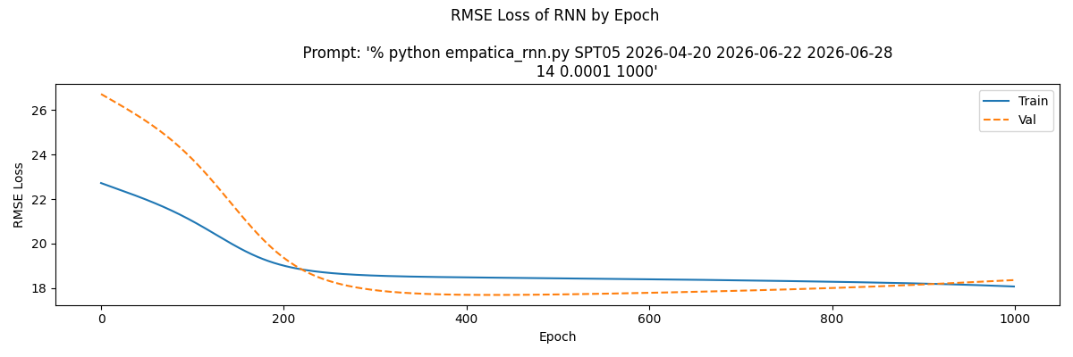
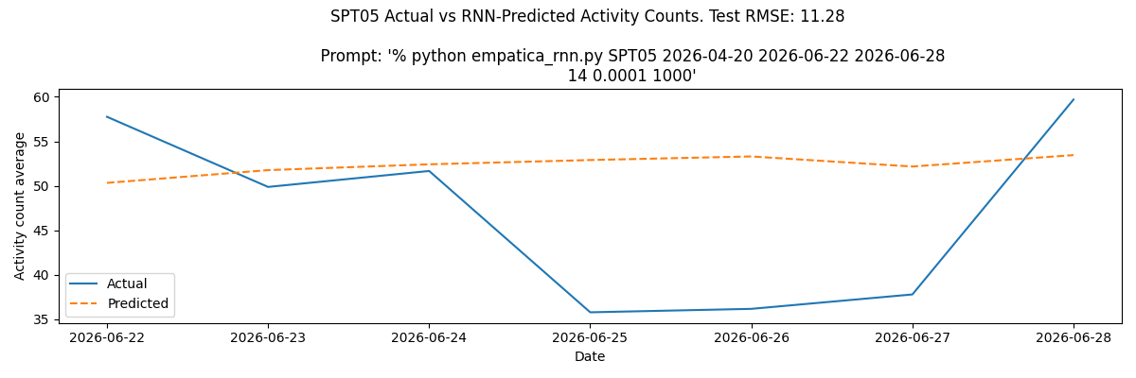
RNN
Train preds plot missing

Slide 8
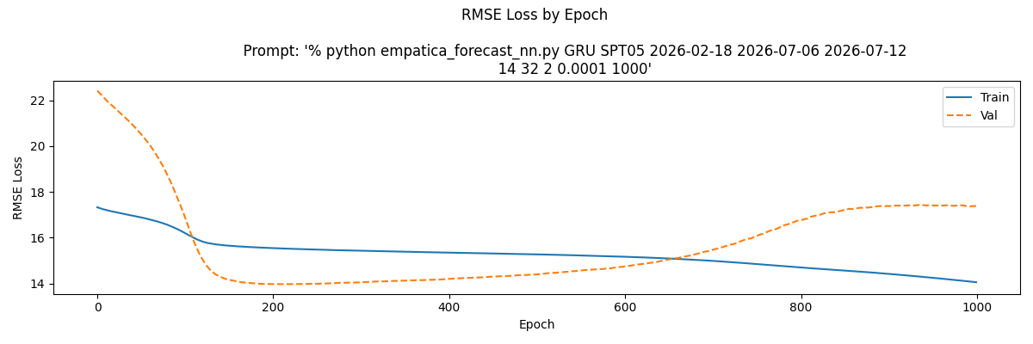
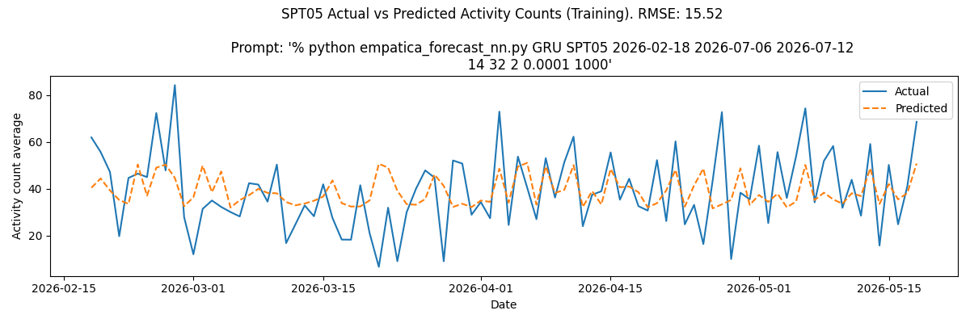
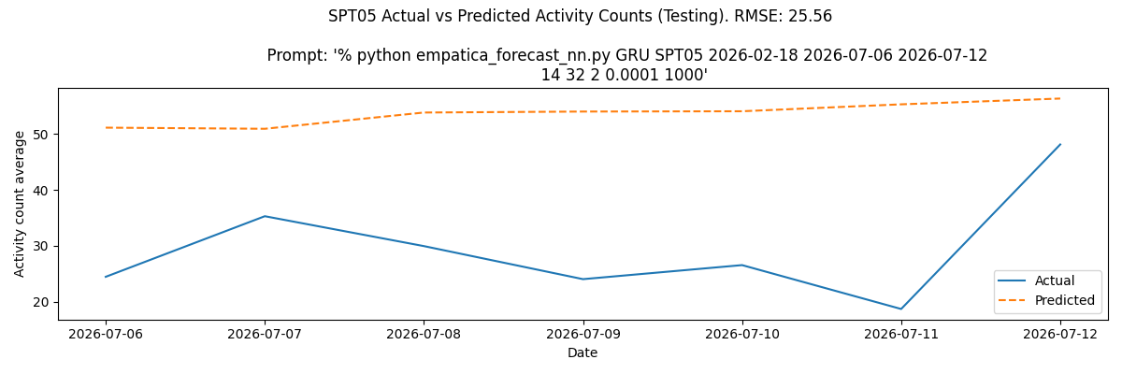
GRU

Slide 9
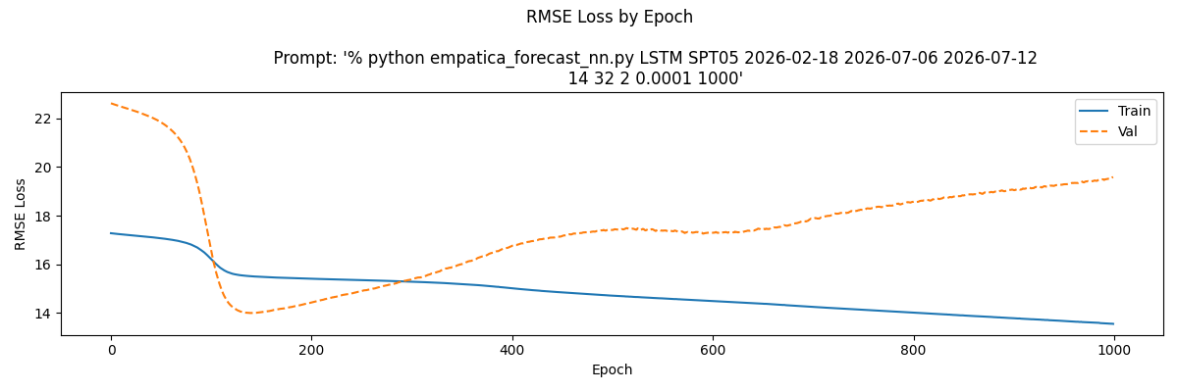
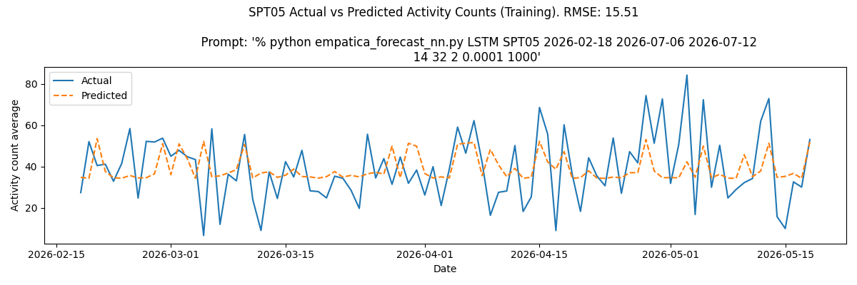
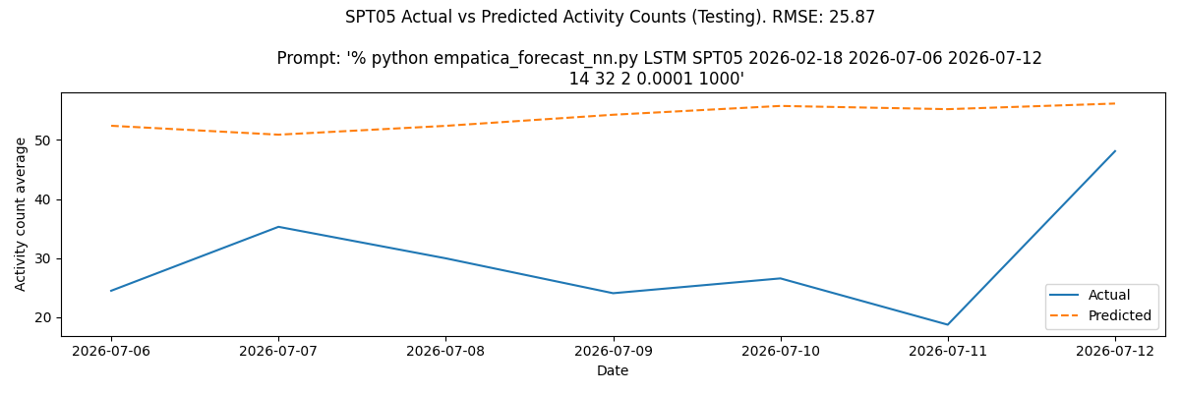
LSTM

Slide 10
NN forecasting conclusions
All NN models gave highly linear predictions on train+test data
  Loss plots show that this is not a result of underfitting; continued training for more epochs resulted in higher val loss
All RMSEs were high (MLP, GRU, LSTM RMSE of ~25 for the same test week) - higher than ETS/ARIMA
Things to come back to/work more on:
Backtest NN models
  The results presented in the previous slides are as vulnerable to weekly variation as the ETS/ARIMA results were before backtesting
Test NNs on other biomarkers than act count (switch to MAPE)

Slide 11
Backtesting ETS and ARIMA models
How do models perform over every slice of the data?
  Do we really beat baselines - or were good results just artifacts of the prediction week?
Are certain sample sizes better than others?
How do predictions compare across biomarkers?
  This required a switch from RMSE to MAPE to enable evaluation across different variable scales

Slide 12
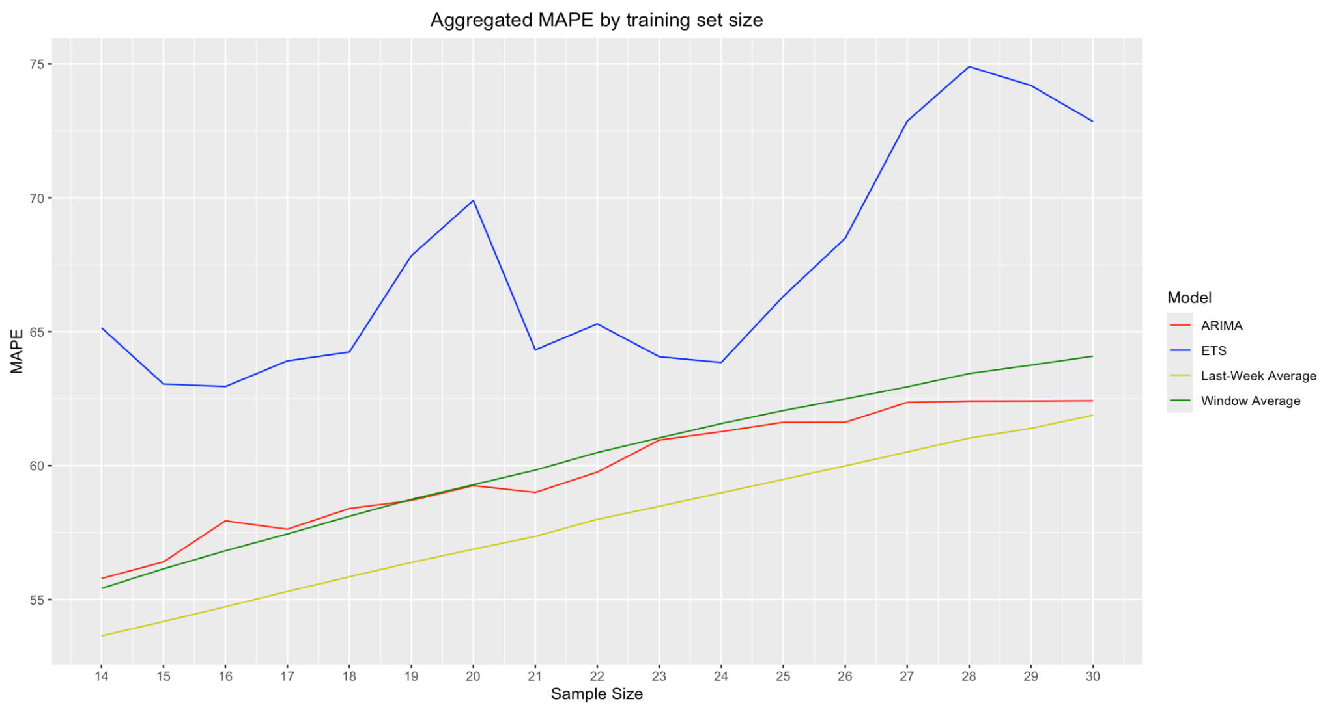
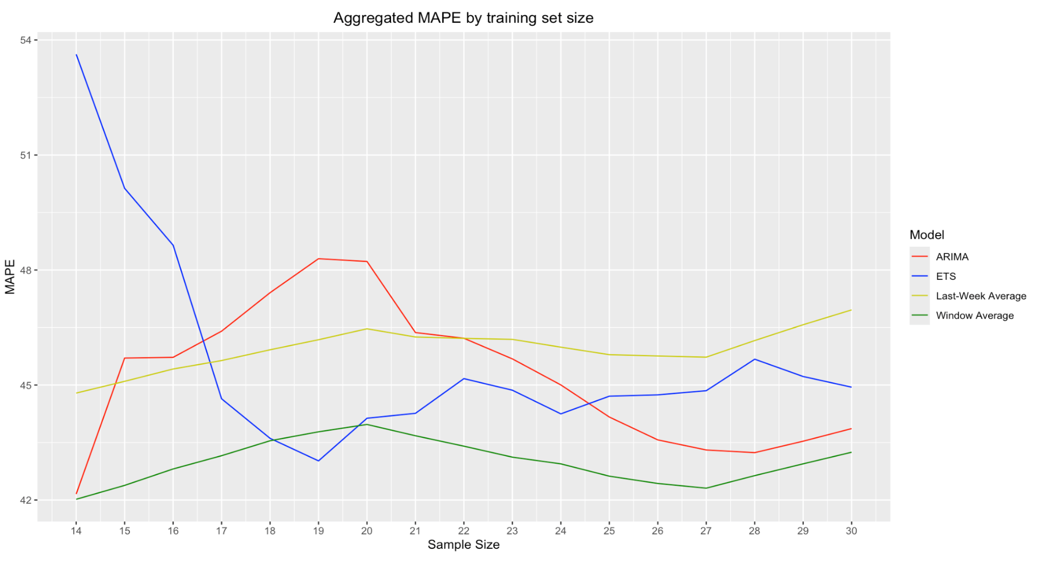
Backtesting Activity Count
SPT04 activity count backtesting
SPT05 activity count backtesting
MAPEs are very high, and for SPT04 also increases with sample size, indicating that complex models perform worse than simple ones.

Slide 13
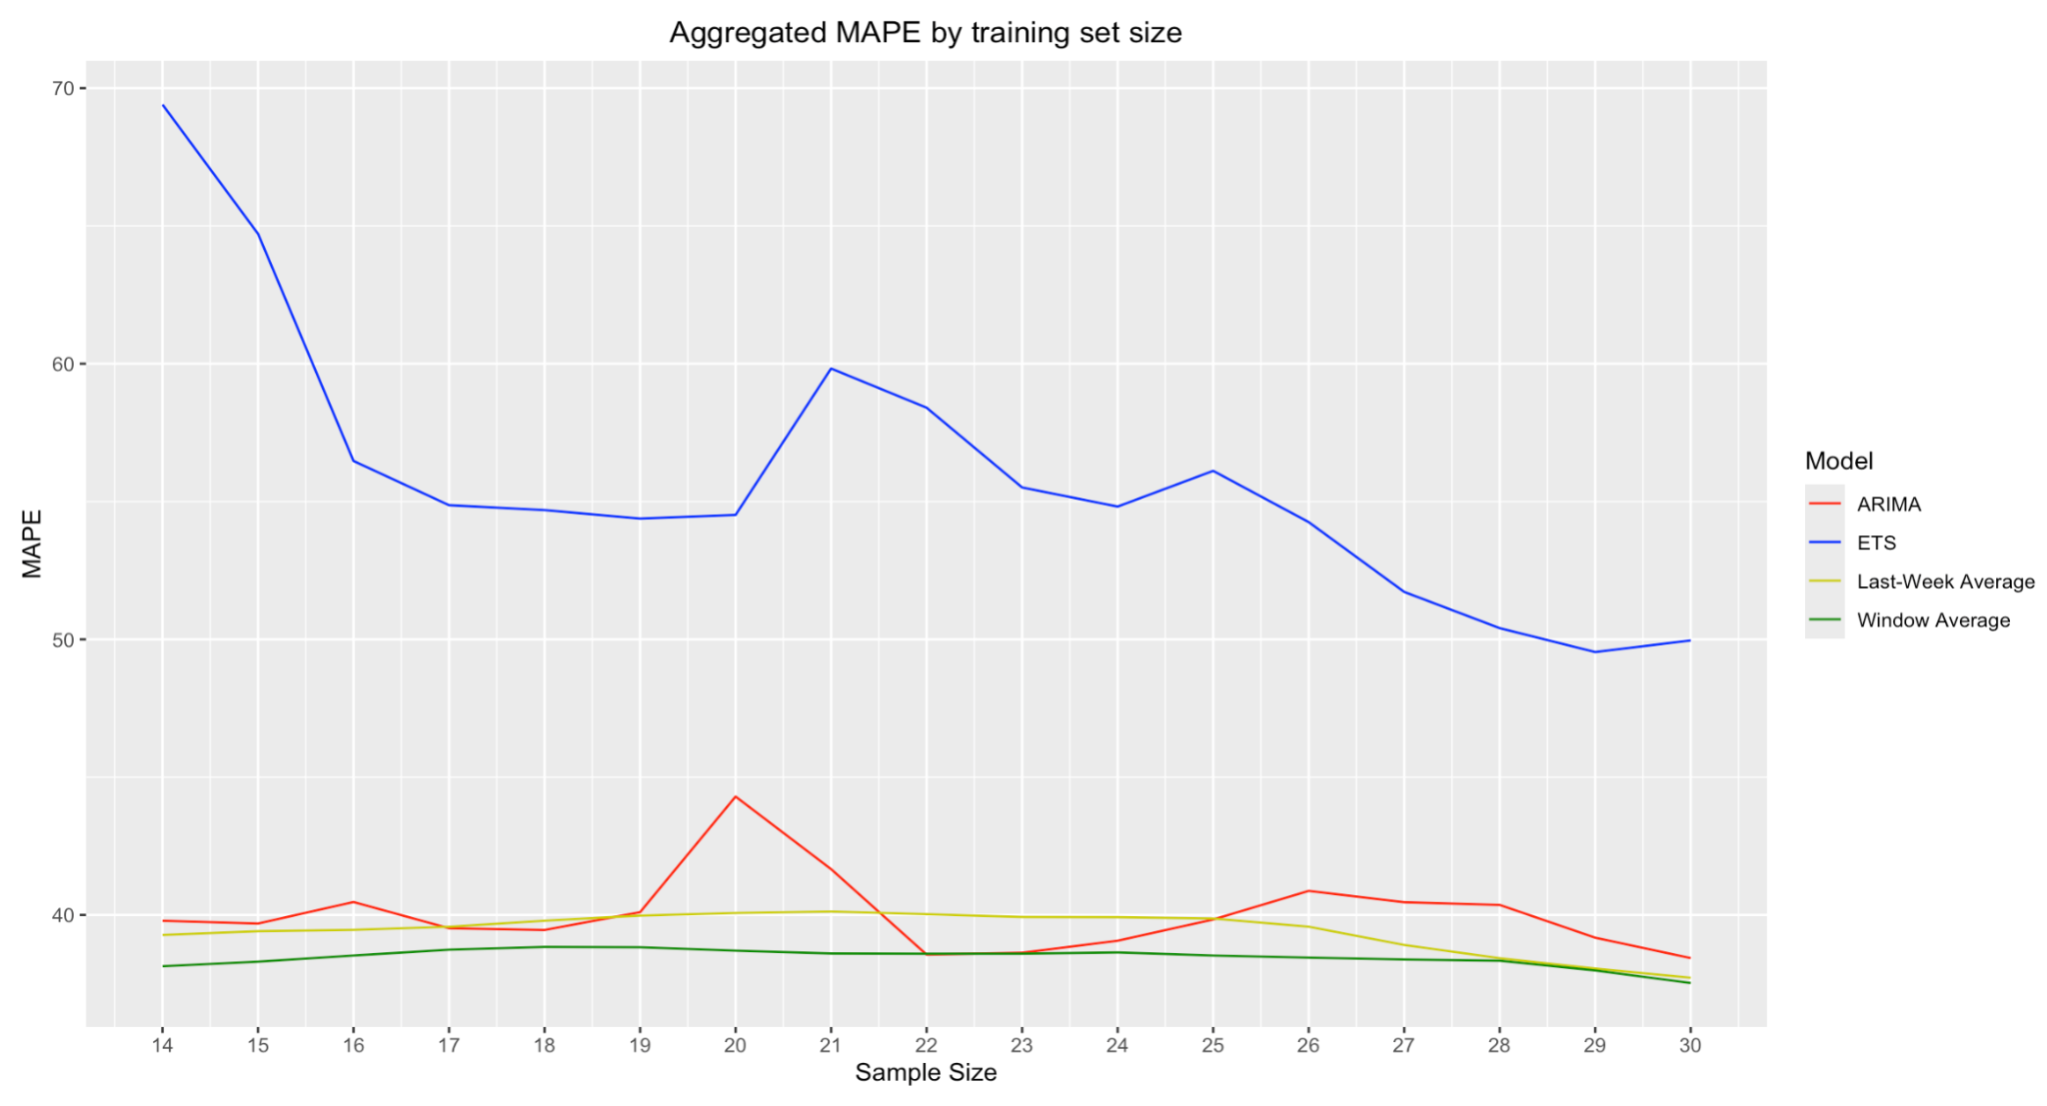
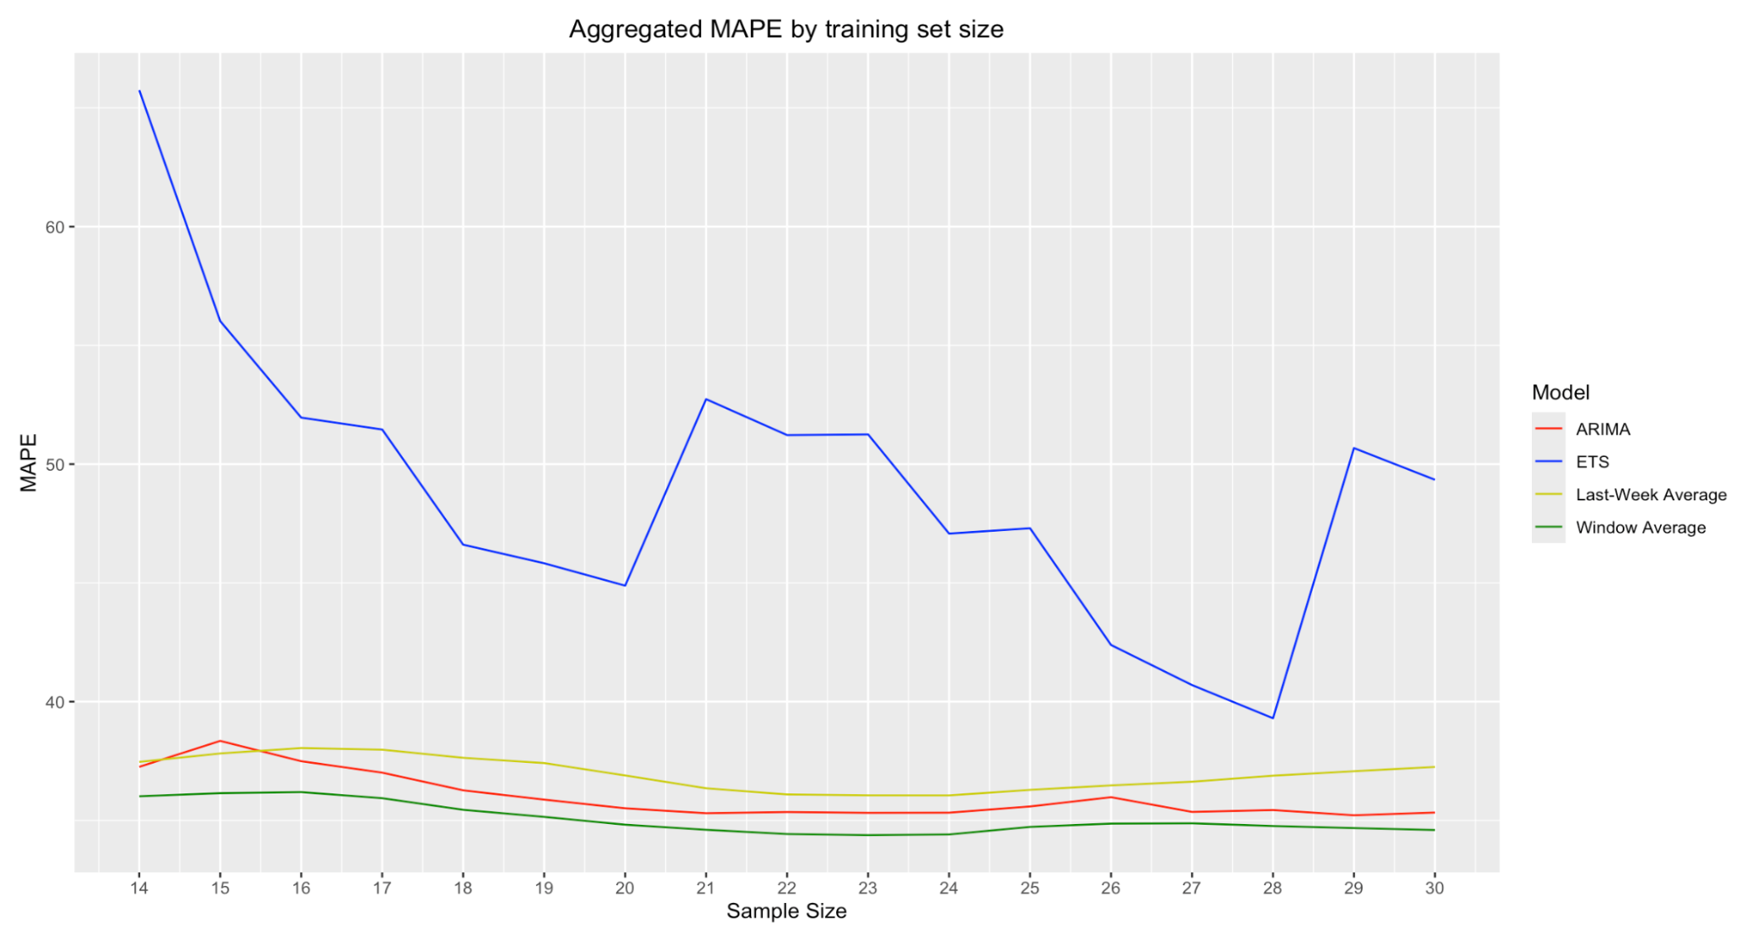
Backtesting Heart Rate Variability
SPT04 hrv backtesting
SPT05 hrv backtesting
Better MAPEs than activity count forecasting,
but average error is still in the 35-40% range.

Slide 14
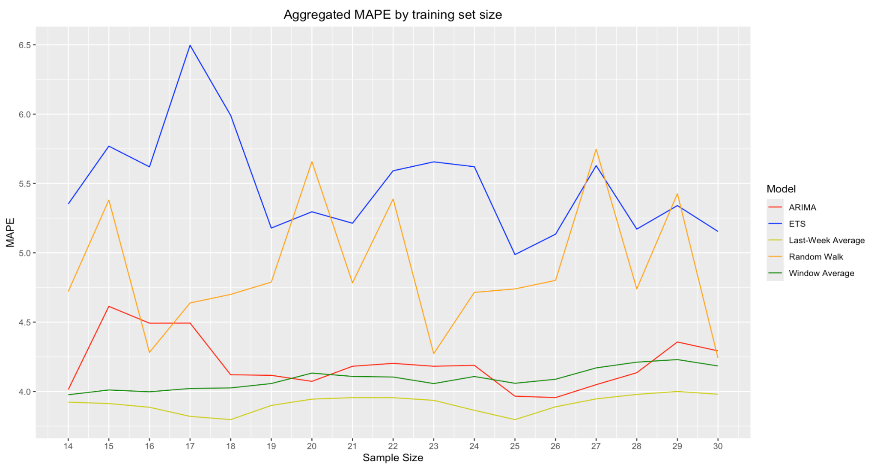
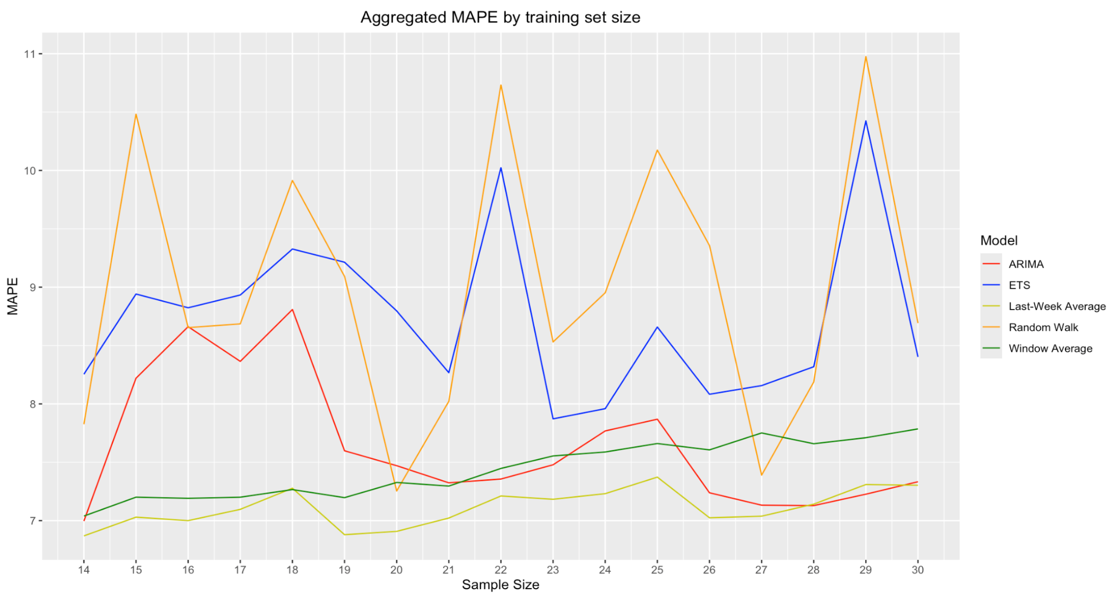
Backtesting Heart Rate
SPT04 hr backtesting
SPT05 hr backtesting
Heart rate yields much better MAPEs than both activity count and hrv.

Slide 15
Backtesting conclusions
After backtesting ETS/ARIMA, we conclude that:
Daily-average forecasting paradigm may still be feasible, as suggested by good performance on heart rate
  Forecasting activity count and HRV may be too difficult due to large inherent variability
  Initial good results were artifacts of a good test week
Good biomarkers may be key to using this forecasting method

Slide 16
Possible next steps
Revisit NN models: Backtest for robust evaluation and try other biomarkers
  Initial evaluation was not robust and is worth checking
  Hyperparameter search could be more expansive and methodical
  If NNs truly don’t beat traditional models/baselines, they can be discarded
Test different biomarkers for forecasting; any that show explanatory power may work out if they have less variance than activity count and HRV
Explore multivariate forecasting - combinations of good biomarkers may have more explanatory power to cut through high variance
Explore other forecasting paradigms
  Maybe reduced horizon is necessary for accuracy (tradeoff)
  Maybe other modelling techniques perform better

